Slide 1
Project 4: Predicting Residential Property Investment
By
Omar Bernal
Victoria Barbosa Munoz
John Tanasijevich
Victor Diaz

Slide 2
Table Of Contents
01
Introduction & Overview
Problem We are Analyzing
Brief Description
Technologies Used
02
Visualizations
Charts that we used to explain trends
State of the housing market pass, present, & future
03
Datasets, Real Estate Tools, & Data Cleanup
04
Machine Learning Deployment & Prediction
05
Conclusions

Slide 3
Introduction & Overview

Slide 4
Problem We are Analyzing And Predicting
We are trying to create an accurate forecast model on which residential properties are a good investment right now.
Perhaps predict a possible market drop
Provide additional information by showing visualizations that demonstrate trends, personal income requirements to buy a home, and property value
Brief Description
The team decided to do this project because of the current state of real estate we are living in.
Null Hypothesis => Housing market will continue to rise
Technologies Used Within Pycaret
One Hot Encoder
Label Encoder
pd.get_dummies
Logistic Regression
Introduction
Overview
&

Slide 5
Visualizations

Slide 6
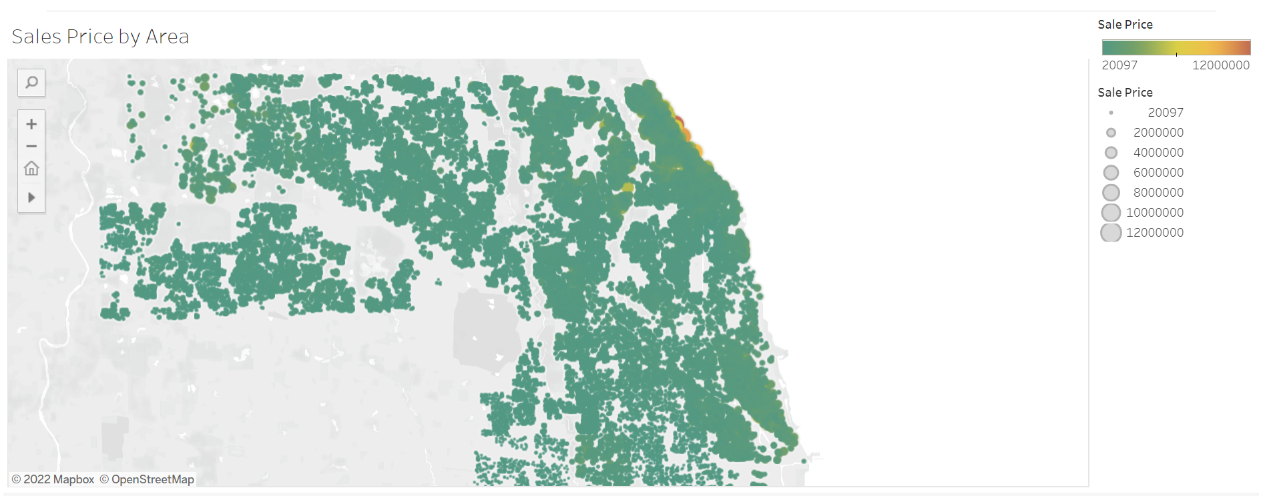
Property value increase
Add Text
$ 23,433,000

Slide 7
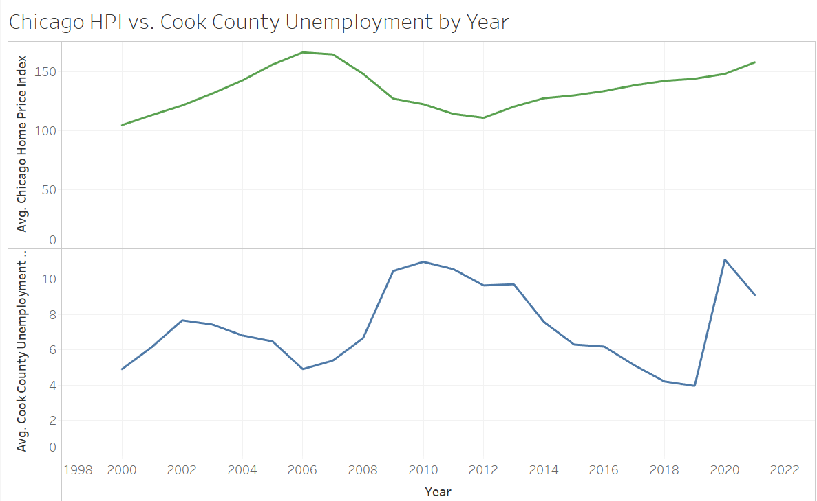
Chicago HPI vs Avg Unemployment By Year

Slide 8
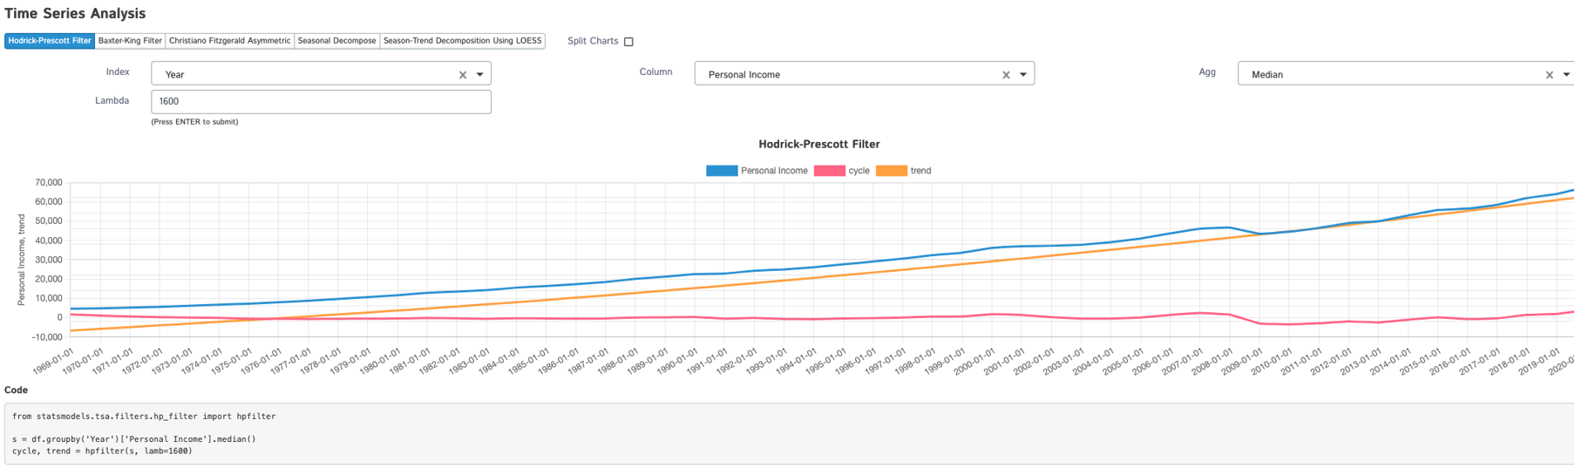
Housing Market Trend vs. Personal Income

Slide 9
Datasets, Real Estate Tools, & Data Cleanup

Slide 10
Brief Description of the datasets for ML models
Cookcounty dataset
Using clusters, it will help to see if the property is a good investment depending on the neighborhoods.
Base on the time we have this is what we saw as being most important.
Cookcountyraw
This dataset was about too large and narrow it down to a few rows.
It was helpful nonetheless because we use this as a base

Slide 11
Machine Learning Deployment & Prediction

Slide 12
Predicting our Investment
Show the class the Machine Learning prediction models

Slide 13
Conclusion

Slide 14
What did we learn?
It is expensive to buy a house
Buying properties is a convoluted process that contains multiple variables (would be able to understand it better if we had a real estate agent input)
Any improvements to be made?
It would great see renting vs. buying home, which option is better currently
Predict a market crash
More time to finish the deployment of our webpage
Hypothesis => Our hypothesis was not true because according our models it predicted a drop off
Limitations?
It was difficult to find the data that we needed in a dataset. As a result, we had to find multiple datasets.
When looking through the dataset the pandemic played a part on showing accurate data.
Finding data under a timeframe was difficult and require it to be filtered.
The team had hardware problems deploying our machine learning(thanks a lot M1 chip!!!!!!!!).
Conclusion

Slide 15
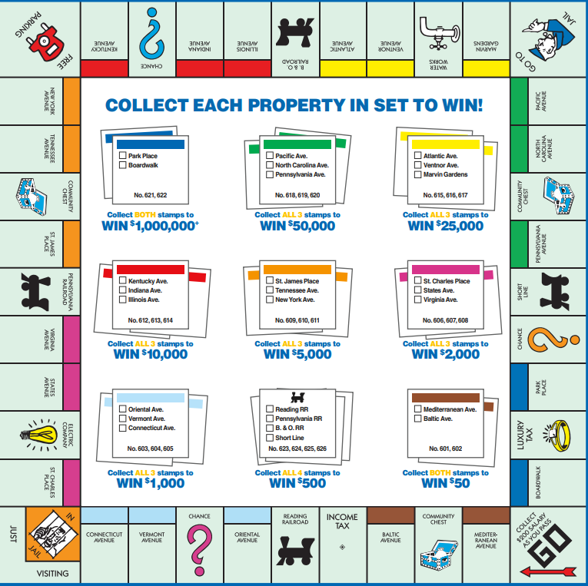
Any Questions????

